Slide 1
Health in All Policies
presentation to
Legislative Health & Human Services Interim Committee
Santa Fe, NM
Tuesday, November 25, 2014
Marsha McMurray-Avila, Bernalillo County Community Health Council
Jacque Garcia, Bernalillo County PLACE MATTERS
Kristina St. Cyr, Doña Ana County PLACE MATTERS
Jordon Johnson, McKinley Community PLACE MATTERS
Notes:
Mr. Chair, Members of the Committee, my name is Marsha McMurray-Avila. I am the Coordinator for the Bernalillo County Community Health Council and the Chair of the NM Alliance of Health Councils. I am also coordinating a project for the New Mexico Public Health Association with funding recently received from the American Public Health Association to share information on the Health in All Policies approach as a way to move us toward healthy policies in our state that address the social determinants of health and health equity.
Our planning committee includes multiple partners: NMPHA, the NM Alliance of Health Councils, individual health councils in Bernalillo and Torrance Counties, Place Matters chapters in Bernalillo, Dona Ana and McKinley Counties, the NM Department of Health, the NM Health Equity Partnership, the Bernalillo County Office of Health & Social Services Health Promotion Team, the NM Chronic Disease Prevention Council and others.
One of our goals for this project was specifically to share this information about Health in All Policies with your committee. So thank you very much for allowing us this time today.
AND I WOULD LIKE TO UPFRONT APOLOGIZE FOR READING MY PRESENTAITON TODAY. I USUALLY DON’T DO IT THIS WAY, BUT IN THE INTERESTS OF TIME I WROTE IT OUT TO KEEP ME FROM STRAYING INTO DIGRESSIONS.

Slide 2
What we’ll cover today…
Review of social determinants of health and equity
Description of Health in All Policies as approach to operationalize how to address the social determinants of health and equity
      Definition and context
      Key elements
      History and background
      Strategies to implement Health in All Policies
Examples from Bernalillo County, Doña Ana County and McKinley County of using a Health in All Policies approach
Notes:
So moving to the first slide… In today’s presentation we will review the role of the social determinants of health and equity in determining the health of our communities. We will then describe Health in All Policies as an approach that can be used to address the social determinants of health and equity in practice. This will be followed by my colleagues providing examples from the Place Matters teams in Bernalillo County, Dona Ana County and McKinley County of local applications of the Health in All Policies approach.

Slide 3
What determines how healthy we are?
GENETICS
MEDICAL CARE
5%
10%
INDIVIDUAL BEHAVIORS
30%
2012 NMAHC/M. McMurray-Avila
Notes:
What determines how healthy we are? Depending on which research or article you look at, it might come out something like what you see in the next slide. Although listed in one article I was reviewing as 5%, genetics I’ve also seen as high as 10-15%. But the impact of medical care tends to usually be around 10%, and at least a third is due to individual behaviors. Of course, it’s immediately obvious that this does not add up to 100%. There’s a big chunk missing. That other 55% or so is what REALLY determines how healthy we are…which you can see in the next slide…

Slide 4
What (really) determines how healthy we are?
2012 NMAHC/M. McMurray-Avila
Notes:
So here is a long list of some of the most recognized social, economic, and environmental determinants of health.
However, we also know that all of these factors are greatly impacted by other social forces that determine the quality and quantity of resources available to individuals and communities in any of these areas. These are the Determinants of Equity…as shown in the next slide…

Slide 5
Equitable Access & Opportunities for All
2012 NMAHC/M. McMurray-Avila
Notes:
We know that poverty, racism, classism, sexism and any other form of discrimination are inequities that have a major impact on the quality and availability of all of these determinants from the built environment all the way through this list down to the working conditions. For this reason, equity is a key principle and value to keep in mind in the following discussion of health in all policies.
We don’t have time to go into it at this point, but we have multiple examples that we’d love to share of how inequities mold the social determinants of health into positive supports or negative consequences in all these different areas. So perhaps we could go into this more in the Q&A if there’s time.
Some examples of this include:
Built Environment – when sidewalks are lacking in poor neighborhoods of color, preventing children from walking safely to school
Education - when policies discourage students through punitive actions such as suspension/expulsion leading to dropping out, rather than providing the appropriate supports to encourage youth to stay in school and graduate (which leads to better health as an adult)
Land Use Policy – when polluting industries are concentrated in poorer neighborhoods, causing increased cancer, asthma, etc.
Transportation - when affordable, accessible mass transit is not available in poor neighborhoods so that people’s health could be improved directly (by walking to and from the bus stop) and indirectly (by improving access to meaningful work or healthy food or necessary services)
Working Conditions – in addition to the obvious impact on health of unsafe working conditions or toxic environments (both physical and emotional) health is also an issue when employees suffer from wage theft (substandard or with-held wages) preventing the ability of the worker to make healthy choices in housing or food, as well as increasing stress leading to further illness

Slide 6
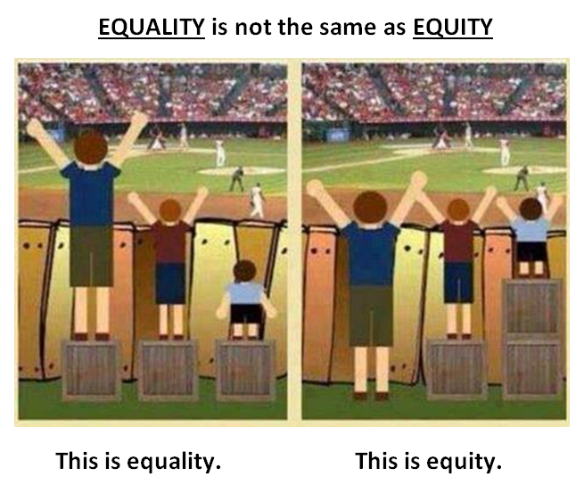
Notes:
A further word about equity in the next slide. Equity is not the same as equality. As you can see here on the left, all children have equal boxes. But the results are not fair. On the right the resources have been distributed so that all have an equal opportunity to see the game. Equity is what assures the appropriate resources so that all have an equal opportunity. I’ve also heard this described as “Equality is giving everyone a pair of shoes. Equity is giving everyone a pair of shoes that fits.”

Slide 7
So what are health policies?
Transportation policy is health policy
Land use policy is health policy
Education policy is health policy
Tax policy is health policy
Agricultural policy is health policy
Economic development policy is health policy
Criminal justice policy is health policy
Notes:
Clearly, what we’re saying here is that policies in any of these sectors are health policy. If you have questions later about the link between health and any of these policies, again we’d be happy to provide examples during the Q&A.
A couple more examples in areas rarely thought of as health policy would be:
Tax policy is health policy – when Earned Income Tax Credits help lift a family out of poverty, allowing that extra money towards safe housing or education or healthier food
Agricultural policy is health policy – when growing healthy food is subsidized or when small organic farmers are linked to providing food for schools or businesses
Economic development policy is health policy – when jobs are created that provide a living wage so that families can afford to make healthier choices in what they eat, where they live, providing safe quality childcare, etc.
Criminal justice policy is health policy – decriminalization of drug use or offering treatment as an alternative to incarceration for people suffering from addictions who commit non-violent crimes have an enormous impact not only on the health of the individual and the chances for a better healthier life in the future, but also have a major impact on that individual’s family. Children of incarcerated parents do worse in school and have poorer physical and mental health outcomes.

Slide 8
SUMMARY: What is health and where does it come from?
Health is “a state of complete physical, mental and social well-being and not merely the absence of disease or infirmity.” (World Health Organization)
Public health is “what we as a society do to collectively assure the conditions in which people can be healthy.” (Institute of Medicine, 1988)
Those conditions can be described as the places where we live, learn, work, and play, and the social, economic and political factors that affect us in those places.
Notes:
Moving to the next slide, in a world where the word “health” is often interpreted to mean “health care” this may all sound confusing. Perhaps these definitions might help.
The World Health Organization defines health as “a state of complete physical, mental and social well-being and not merely the absence of disease or infirmity.”
And the Institute of Medicine in 1988 declared that public health is “what we as a society do to collectively assure the conditions in which people can be healthy.”
Those conditions are often described today as the places where we live, learn, work, and play, and the social, economic and political factors that affect us in those places.

Slide 9
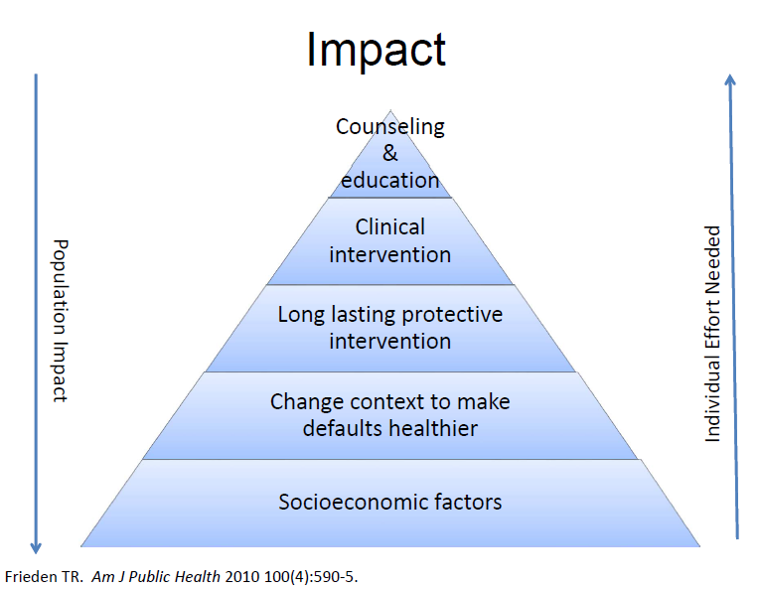
Notes:
In the next slide from Tom Frieden of the CDC, you can see how the impact on the health of the entire population is greatly maximized by focusing on the bottom of the pyramid where we find the socioeconomic factors which represent those conditions we are working to improve. At the top are individual solutions that may help a few people, but do much less to change the overall health of the population. It is of note that clinical intervention, i.e., medical care, is near the top of the pyramid… much less impactful in creating a healthy society, but clearly the most costly of all efforts shown.

Slide 10

Context…
The public health challenges of the 21st century are extremely complex, and solutions will require actions that go beyond the purview of public health, bringing together partners across policy areas and sectors.
Messy, wicked problems
Notes:
And since real life does not usually divide itself neatly into pyramid charts, let’s add some context as you can see in the next slide. We all know the challenges we face. They’re extremely complex and the solutions go way beyond our public health boundaries. These kinds of complex problems are also known as wicked problems or social messes.

Slide 11
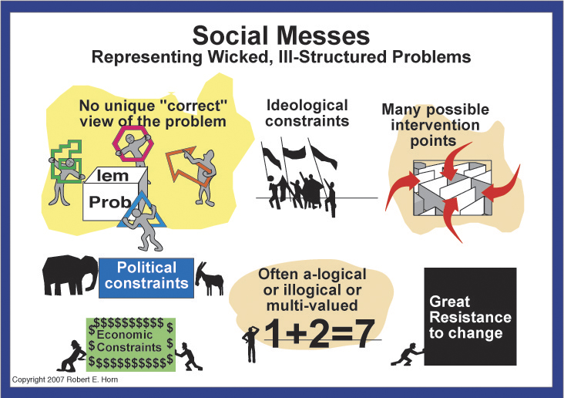
Notes:
In the next slide you see a graphic look at why we call these social messes. I’m sure you can relate this to many of the problems you all deal with. First, there is no unique or “correct” view of the problem. There are many ideological, political and economic constraints. There are many possible intervention points or ways to solve the problem. Frequently neither the issue nor the results is linear. The synergy of 1 + 2 may actually equal 7. And, of course, in trying to solve these wicked problems, there is great resistance to change.

Slide 12
That’s all great in theory…
How do we put it into practice?
“Health in All Policies” (HiAP) is a way to operationalize the understanding that our health is affected by multiple sectors of our society and those sectors all have a role to play in helping us get and stay healthy.
HiAP is a collaborative approach to improving the health of all people by incorporating health considerations into decision-making across sectors and policy areas.
HiAP, at its core, is an approach to addressing the social determinants of health that are the key drivers of health outcomes and health inequities.
HiAP is an approach, a process and a philosophy.
Notes:
So… this is a lot of words to describe some powerful concepts. But clearly, just talking about the social determinants of health or equity is not going to change health outcomes or make communities healthier or more equitable. Moving to the next slide we see how Health in All Policies is a way to actually operationalize and put into practice this understanding of social determinants of health, recognizing that we need all the different sectors involved in this work that play a role in creating (or negatively impacting) health.
The primary definition of HiAP is a collaborative approach to improving the health of all people by incorporating health considerations into decision-making across sectors and policy areas.
At its core this is an approach to addressing the social determinants of health we looked at before, that are the key drivers of health outcomes and health inequities.
It’s also important to note that HiAP is an approach, a process and a philosophy. It is not a fixed step-by-step process or methodology like Health Impact Assessments, which are one tool that can be used in this process.

Slide 13
HiAP – 5 Key Elements
Promote health, equity and sustainability
Support intersectoral collaboration
Benefit multiple partners
Engage stakeholders
Create structural or procedural change
Notes:
SO HiAP is an approach to get different sectors to collaborate on solving problems that affect our health by supporting healthy policies.
In the next slide you see the principles that must be included in HiAP work.
Promote health, equity and sustainability
Support intersectoral collaboration
Benefit multiple partners
Engage stakeholders
Create structural or procedural change
We’ll go into each of these individually…

Slide 14
1. Promote health, equity and sustainability
HiAP promotes health, equity and sustainability
through two avenues:
Incorporating health, equity and sustainability into specific policies, programs, and processes, and
Embedding health, equity and sustainability considerations into government decision-making processes so that healthy public policy becomes the normal way of doing business. Promoting equity is an essential part of HiAP given the strong ties between inequity and poor health outcomes.
Notes:
The overall purpose or outcome is promotion of health, equity and sustainability. This can be done either at the level of individual policies, programs or processes (which is one of the places we use Health Impact Assessments) OR by embedding into the actual government decision-making processes so that healthy public policy becomes the normal way of doing business, with the promotion of equity in a central role.

Slide 15
2. Support intersectoral collaboration
HiAP brings together partners from many sectors to:
recognize the links between health and other issue and policy areas,
break down silos,
build new partnerships to promote health and equity, and
increase government efficiency.
Notes:
Moving to #2 – This can clearly only be accomplished through collaboration across sectors… breaking down the silos and building new partnerships is key to this approach.

Slide 16

Breaking down silos…
LAND USE PLANNING
EDUCATION
ECONOMIC
DEVELOPMENT
TRANSPORTATION
Agencies that are not typically considered as health agencies play a major role in shaping the economic, physical, social, and service environments in which people live, and therefore have an important role to play in promoting health and equity.
Notes:
An additional word on silos here, looking at the next slide…Think about those agencies that are not typically considered as health agencies and the role that they play in shaping the economic, physical, social and service environments in which people live, for example land use planning, education, transportation, economic development. We clearly cannot promote health and equity without getting past this silo mentality and working together.

Slide 17
The Silo Culture Impedes HiAP
Defining characteristics of silos include:
distinct funding streams – governmental budgets directed to specific departments
competition for funding and credit
self-preservation within the system
Notes:
What creates the silo mentality? In the next slide we see that the culture of silos is defined by characteristics that include (among others):
Distinct funding streams, for example, when governmental budgets are directed to specific departments, rather than to specific issues that could be worked on collectively by several departments
This creates competition not only for funding, but also for credit (since that is often seen as leading to more funding)
- And the result of all this is a state of self-preservation within the system – survival trumps service

Slide 18
3. Benefit multiple partners
HiAP is built upon the idea of “co-benefits” and “win-wins.” HiAP work should benefit multiple partners, simultaneously addressing the goals of public health agencies, other government agencies and community stakeholders to benefit more than one end (achieve co-benefits) and create efficiencies across sectors (find win-wins).
Notes:
This last point of self-preservation is key to the 3rd principle in the next slide. Everyone in all these silos needs to feel that they’re benefitting. We need to find solutions that are “co-benefits” and “win-wins” – solutions that can have more than one positive outcome in more than one sector. I sort of think of this as coaxing people out of their silos with incentives and benefits and valuing their priorities, rather than just going in and breaking down their silo in a destructive or disrespectful way.
Public health practitioners have a unique role to play in improving the quality of life in our nation, but genuine efforts to improve health must be made in partnership with other sectors.
LEAVE OUT:
The concept of co-benefits is essential for:
securing support from partners
reducing redundancies, and
ensuring more effective use of scarce government resources.
Finding a balance between multiple goals will sometimes be difficult, and requires negotiation, patience, and learning about and valuing others’ priorities.

Slide 19
4. Engage stakeholders
HiAP engages a variety of stakeholders, beyond government partners, such as community members, policy experts, advocates, the private sector, and funders. Robust stakeholder engagement is essential for ensuring that work is responsive to community needs and for garnering valuable information necessary to create meaningful and impactful change.
Notes:
The 4th principle seen in the next slide is to always engage stakeholders. In HiAP lingo, “partners” are within government and “stakeholders” are those outside of government, like community members, policy experts, advocates, the private sector and funders. Whether we call them stakeholders or community partners, they must be engaged as a fundamental part of this work – both to insure that the work is responsive to community needs and to make sure we have all the information necessary for meaningful change.

Slide 20
5. Create structural or procedural change
Over time, HiAP creates permanent changes in how agencies relate to each other and how government decisions are made. This requires maintenance of:
structures which can sustain intersectoral collaboration
mechanisms which can ensure a health and equity lens in decision-making processes across the whole of government.
This can be thought of as “embedding” or “institutionalizing” HiAP within existing or new structures and processes of government.
Notes:
So the last principle, as seen in the next slide, is that HiAP should result in permanent changes in how government decisions are made, as well as how agencies relate to each other and work together. This can require new structures that are able to sustain intersectoral collaboration, as well as processes that can ensure a health and equity lens in decision-making across all government entities. This is where we talk of embedding or institutionalizing HiAP into the decision-making process.

Slide 21
Strategies for implementation
HiAP actions and groups can take many forms. It can be implemented through:
application to existing processes such as strategic planning, individual initiatives and grant-making
creation of a new structure or group, e.g., task force
or both
Many options exist for how to consider health in decision-making, from using formal health impact assessment tools to an informal application of a health lens. Partners, leaders, and focus areas will vary, depending upon political support, community needs, and resources.
Notes:
There are many ways this can be done, as seen in the next slide. It could be applied to processes already ongoing - such as strategic planning, grant-making or other initiatives - or through establishment of a new task force or other group or structure, or both.
And there are many ways to incorporate the consideration of health into decision-making, from using formal HIA tools as mentioned before, to an informal application of what we call a health lens.

Slide 22
Examples where HiAP can contribute to current policy discussions and projects in NM
Legalization of marijuana
J. Paul Taylor Task Force
Statewide Long Range Transportation Plan
Race to the Top
Obesity prevention projects across NM that link to other sectors
Notes:
Moving to the next slide, there are several examples of current policies or projects in NM where a HiAP approach is being applied, or could be applied. Some of these include:
We can have further discussion about any of these in the Q&A if needed.
Legalization of marijuana – involves the criminal justice and public safety systems; decreasing incarceration for possession of marijuana impacts not only the health of the users, but their families. Incarceration of a parent is a disruptive force in the life of children/youth, leading to later health problems. Incarceration also impacts an individual’s possibilities for employment and housing, both of which affect physical and mental health.
J. Paul Taylor Task Force – child abuse and adverse childhood experiences are powerful determinants for later adult health, which supports the need for involving early childhood services, social services for families, child protective services, behavioral health services, housing, and education all early on to prevent those adverse experiences
Statewide Long Range Transportation Plan – It’s my understanding that the Department of Transportation invited public health representatives into the planning process, making it a public health and safety plan
Race to the Top – involving multiple departments to improve education, with a focus on young children
Obesity prevention projects across NM - Healthy Kids Healthy Communities across NM, the new CDC-funded Racial & Ethnic Approaches to Community Health (REACH) in Bernalillo County, all using multi-sector approaches to increase access to physical activity opportunities and access to healthy foods. Policies in other sectors – built environment, education, agriculture – all become an opportunity to examine the impact on health, in this case specifically obesity.

Slide 23
New Mexico
Health in All Policies Task Force
Our HiAP Work Group requests the formation of a Health in All Policies Task Force consisting of multi-sectoral representatives of departments in state government, as well as multi-sectoral stakeholders from community-based organizations, either:
Legislatively through a Memorial OR
Administratively by building on the NMDOH current long-range planning process
Notes:
Moving to the next slide - To encourage the use of the Health in All Policies approach across all government decision-making, our work group is requesting the formation of a NM Health in All Policies Task Force consisting of multi-sectoral representatives of departments in state government, as well as multi-sectoral stakeholders from community-based organizations and local government agencies.
This could be done legislatively through a Memorial OR administratively by building on an existing long-range planning process within DOH which I believe is looking ahead to 2030.
Examples of the departments:
Department of Health
Department of Transportation
Environment Department
Aging & Long-Term Services
Department of Agriculture
Children, Youth & Families Department
Human Services Department
Corrections Department
Department of Public Safety
Energy, Minerals & Natural Resources Department
Economic Development Department
Public Education Department etc etc etc etc etc w/ community……

Slide 24
Examples of Formalizing
Health in All Policies Work
Rhode Island Commission for Health Advocacy and Equity (2011)
Healthy Chicago (2011)
Seattle/King County Equity Ordinance (2010)
California Health in All Policies Task Force (2010)
Notes:
You can see in the next slide that the Health in All Policies approach has been formalized in several locations across the country from local governments to state governments, from Rhode Island to Chicago and Seattle/King County. We’d like to quickly provide a little background specifically on the California experience since they were pioneers in this at the state level.

Slide 25
California HiAP Task Force: Establishment
2010: Executive Order by Gov. Schwarznegger directs Strategic Growth Council (SGC) to establish Health in All Policies Task Force
  Purpose: “to identify priority programs, policies and strategies to improve the health of California while advancing the SGC’s goals”
  Facilitated by CA Dept of Public Health (CDPH)
  Extensive engagement of stakeholders
2012: HiAP Task Force recognized by Senate Concurrent Resolution and codified within newly established Office of Health Equity in CDPH
Task Force meetings staffed through partnership with Public Health Institute, funded by California Endowment and others
Notes:
We have extensive information on the California experience in this HiAP: Guide for State and Local Governments for anyone who is interested in more detail. I am including information here from slides that Michael Hely generously shared with me from a conference he attended in Atlanta.
The California HiAP Task Force was established in 2010 by Executive Order by Gov. Schwarznegger, building on the Strategic Growth Council they had established in statute in 2008. The Task Force is facilitated by the CA Dept of Public Health, with extensive engagement of stakeholders, staffed in partnership with the Public Health Institute and funded in part by the California Endowment.

Slide 26





California HiAP Task Force:
Aspirations for All Californians
Option to safely walk, bike or take public transit to school,
work and essential destinations
Live in safe, healthy, affordable housing
Access to places to be active, including parks,
and healthy tree canopy
Live and be active in communities
without fear of violence or crime
Access to healthy, affordable foods
at school/work/near home
California’s decision-makers are informed about the health consequences of various policy options
in the policy development process
Notes:
In the next slide you see the aspirations they set for themselves – their practical vision. Although this is not a comprehensive prevention strategy, they chose those things they could work on now, like physical activity, transportation, healthy housing, parks, safe neighborhoods free from violence and crime, and access to healthy food.
Their most important aspiration is that California’s decision-makers be informed about the health consequences of various policy options in the policy development process.

Slide 27
California HiAP Task Force:
What is our value added?
“What unique role can we play as a state-level body?”
Facilitating collaboration: convening/aligning goals across agencies
Building cross-sectoral understanding, especially where causal relationships are not obvious
Shaping funding streams/affecting allocations
Providing analytic tools & guidance for local decision-making
Gathering & sharing data, through stakeholders’ engagement & otherwise
Notes:
Moving to the next slide, the California HiAP Task Force asked itself the following question “What unique role can we play as a state-level body?” and the answers provide some ideas for beginning to define the role of a statewide task force here:
Facilitating collaboration: convening/aligning goals across agencies
Building cross-sectoral understanding, especially where causal relationships linking different sectors and health are not obvious
Shaping funding streams/affecting allocations
Providing analytic tools & guidance for local decision-making
Gathering & sharing data, through stakeholders’ engagement & otherwise

Slide 28
Health in All Policies at the local level in New Mexico:
Bernalillo County
Doña Ana County
McKinley County
Notes:
I will now turn the presentation over to my colleagues from the Place Matters teams in Bernalillo County, Dona Ana County and McKinley County who will briefly share on-the-ground information/ideas for how a Health in All Policies Task Force could support the work they do at a local level.

Slide 29
PLACE MATTERS for health:
Addressing the root causes of racial and ethnic health inequities
Notes:
[Jacque introduces herself and begins…]

Slide 30
The Facts…
Many people of color have poorer health than national averages in the form of higher rates of infant mortality, chronic disease and disability, and premature death.
Many public health researchers believe that the fundamental problem underlying these inequities is residential segregation, which shapes health resources, risks, and life opportunities.
Racial and ethnic minorities are more likely than whites to live in segregated, high-poverty communities, communities that have historically suffered from a lack of health care investment.
Many of these communities also face a host of health hazards – such as high levels of air, water and soil pollution, and a glut of fast food restaurants and liquor stores – and have relatively few health-enhancing resources, such as accessible healthy food or safe places to exercise or play.
Notes:
There’s a lot in this slide, but the main idea here is that many low income communities and communities of color suffer from higher rates of infant mortality, chronic disease and disability, and premature death. Why? Because the people in these communities live in areas with high levels of air, water and soil pollution, an abundance of fast food eateries and liquor stores. They have no access to safe and healthy places to play and exercise.

Slide 31
PLACE MATTERS
…is a national initiative of the National Collaborative for Health Equity designed to build the capacity of local leaders around the country to identify and improve social, economic, and environmental conditions that shape health. The objective of this initiative is to eliminate health disparities by identifying their complex underlying causes and defining strategies to address them.
Addressing upstream causes of health (such as environmental health risks and issues related to employment, education, poverty, and housing) through community action, policy development, and measuring the indicators associated with these determinants of health are at the heart of our PLACE MATTERS work.
Notes:
In summary, the PLACE MATTERS initiative is designed to build the capacity of local leaders around the country. The goal is to eliminate health disparities by identifying and improving social, economic, and environmental conditions that shape health, and we do this by addressing upstream causes of health such as environmental health risks and issues related to employment, education, poverty, and housing.

Slide 32
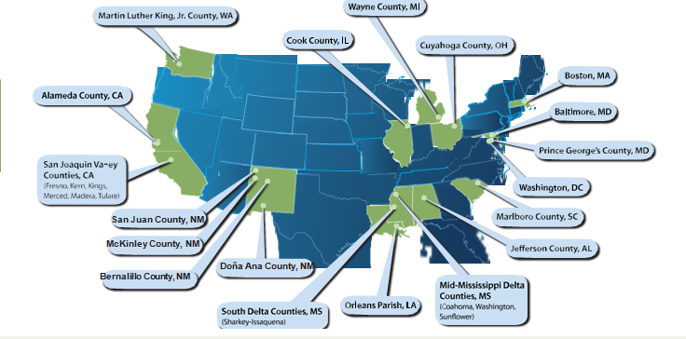
Notes:
This is to show the 19 PLACE MATTERS teams all over the country. New Mexico has four of those 19 teams.

Slide 33
Bernalillo County
PLACE MATTERS

Slide 34
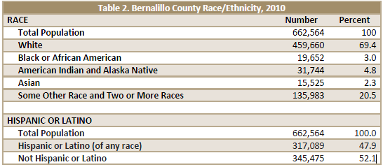
In Bernalillo County
Notes:
My PLACE MATTERS team works with low-income communities of color in Bernalillo County. And I just want to point out that Bernalillo County has a third of the state’s population, so there are many complex issues that arise. We work primarily in the South Valley and in the Southeast Heights also known as the International District. I’ll briefly describe what’s going on in one of our communities.

Slide 35
Impacted Communities in Bernalillo County
Notes:
San Jose and Mountain View are neighboring communities in the South Valley and experience poorer health outcomes than other places in the county.

Slide 36
Polluting Industries in Mountain View
31 out of 36 EPA regulated polluting industries located in the South Valley are located in Mountain View
There are 16 major air pollutant industries
In addition to the 16 major air pollutant
there are 66 + smaller industries
Notes:
One reason for poor health is that: Of the entire South Valley, 31 out of the 36 EPA regulated polluting industries are located in Mountain View.

Slide 37
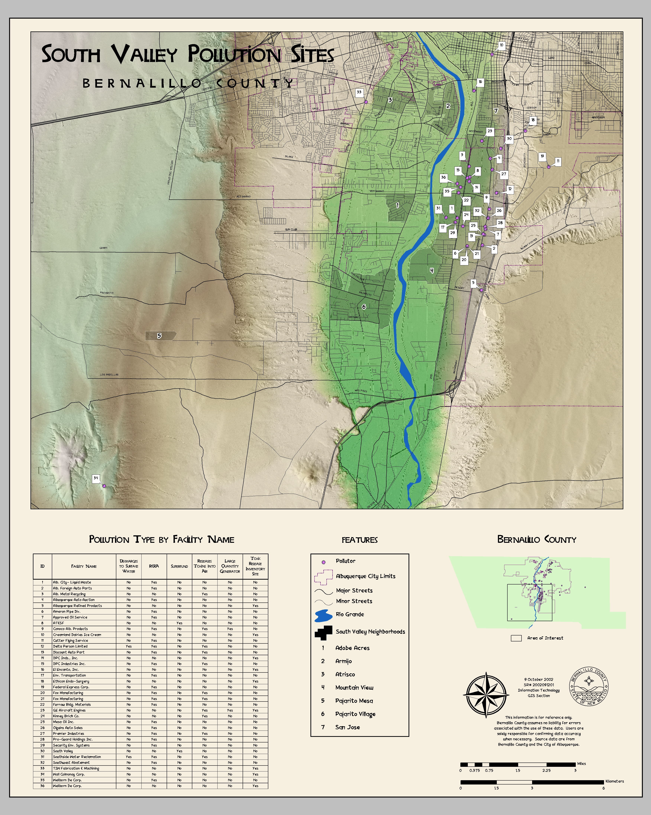

Slide 38
Why are people dying?
The five leading causes of death in Bernalillo County are:
  Heart disease
  Neoplasm, malignant
  Chronic lower respiratory diseases
  Cerebrovascular disease
  Diabetes mellitus

Slide 39
The Economic Impact of Poor Health
Chronic disease has an economic impact in Bernalillo County. In 2007 the Milken Institute estimated that significant reductions in obesity and other chronic disease-related risk factors could save New Mexico over $6 billion in treatment-related costs as well as costs due to lost work productivity by 2023. A 2009 report from the New Mexico Department of Health stated that, “an estimated $390 million was spent overall in New Mexico on healthcare services for heart disease; lost productivity amounted to an additional $780 million in New Mexico.”
Notes:
If we address the root causes of poor health and start creating and implementing laws with the community’s health in mind, it could save New Mexico billions of dollars!

Slide 40
So now what?
We need to work across sectors to make sure we are creating laws with a “Health in all Policies” approach.
We can’t have a productive population and think about economic development if we don’t have a healthy population.
WE NEED YOUR HELP!

Slide 41
Doña Ana County
PLACE MATTERS
Notes:
Kristina introduces herself…

Slide 42
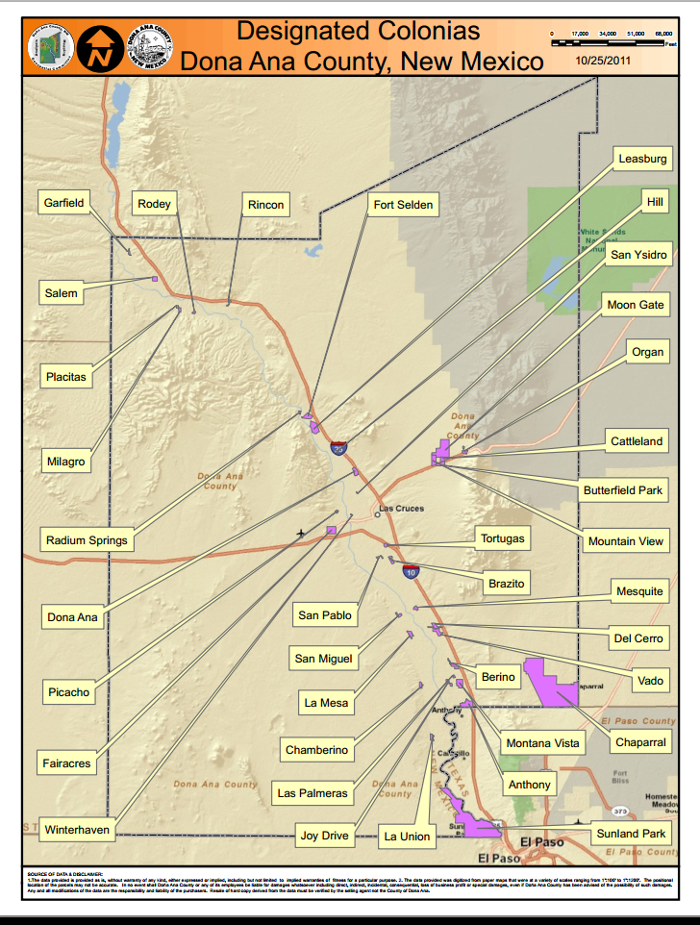
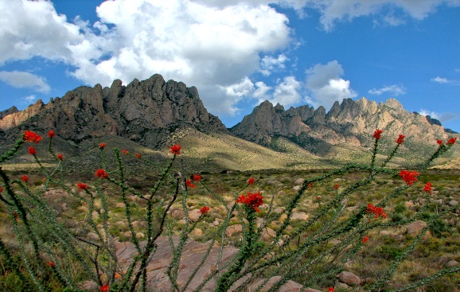
Location/Demographics
210,000
County population
60,000
Live in rural and small communities
66%
Hispanic origin
51%
Speak Spanish at home
*Data from Doña Ana County Community Health Profile
Notes:
The primary population served by the PLACE MATTERS team is the Doña Ana County population of over 214,000 individuals (according to the 2012 US Census), with 60,000 residents living outside the City of Las Cruces in smaller incorporated and unincorporated areas including thirty-seven (37) Colonia communities.
The term "Colonia" has been borrowed from the Spanish term for a residential neighborhood. In the United States, a "colonia" has a specific meaning, referring to a community within the mainly rural US-Mexico border region with marginal conditions related to housing and infrastructure, according to the US Department of Housing and Urban Development.
The demographics of the region are predominantly Hispanic (66%) to 29% White Non Hispanic. Additionally, according to the 2012 US Census the percent of persons below the poverty rate is more than 25%.

Slide 43
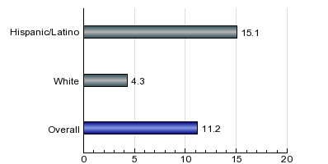
Health Issues
Adults with Diabetes by Race/Ethnicity
Percent
*Data from Doña Ana County Community Health Profile & NM BRFSS
Notes:
Some of the major health concerns in our county are the high rates of obesity, diabetes, and other related outcomes associated with these diseases. As you can see on the obesity chart, over 68% of adults in Doña Ana County are obese or overweight. Obesity is known to increase the likelihood of diseases such as heart disease, type 2 diabetes, and some types of cancer.
So much of our county lacks amenities such as paved roads, sidewalks, streetlights, mass transit, and grocery stores. These realities present challenges to community members in terms of getting out and exercising, purchasing fresh fruits and vegetables, and regularly seeing a healthcare professional, and in turn contribute to our county’s high levels of chronic diseases.

Slide 44
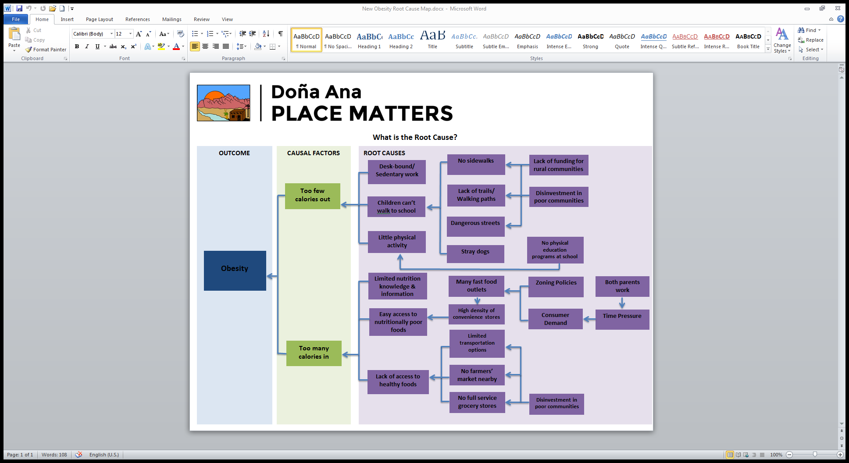
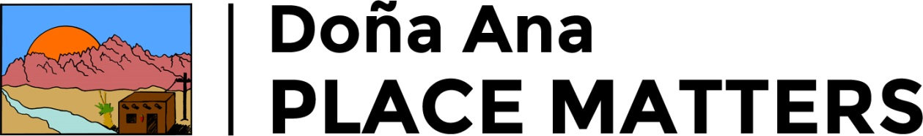
Addressing the issues
The Doña Ana County Comprehensive Plan has a high degree of potential to affect environmental and social determinants that impact health outcomes. Determinants include: cost of housing /transportation, access to education, jobs, and healthy food, poverty and the natural and built environment.
Notes:
To combat these high levels of disease, we are beginning what is called a Health Impact Assessment on the County’s Comprehensive Plan. This assessment will look at the potential health outcomes of the plan as it stands, and make recommendations to promote greater, more positive health outcomes in our community.
The Comprehensive Plan is currently being developed and will include goals, objectives and policies designed to improve the quality of life for residents of Doña Ana County. The overriding themes of Viva Doña Ana projects are targeted to address people, places and prosperity. This HIA will focus on places and specific topics that include, but are not limited to, land use, open space and valued place, and agriculture.
The potential impacts of the HIA will strengthen the relationship between the community development entities, policy decision-makers, advocates for healthy communities and most importantly community residents and thus demonstrating how health can be used in decision – making related to community planning in advancing health equity.
Intersectoral Partners: Community Foundation, HHS, County Development Department, DOH, Non-profits, Community groups, NMSU, City, Promotoras, etc.
Having a statewide Health in All Policies Taskforce will help to strengthen the work that is already taking place in Doña Ana County, it will encourage more non-health entities, which often have a great influence on health, such as planning departments, university sectors, and others to work together towards a healthy community for all.

Slide 45
McKinley Community
PLACE MATTERS
Notes:
Jordon introduces himself…

Slide 46
Race/Ethnicity Demographics
* Data NM Indicator Based Information System

Slide 47
Age Demographics
* Data NM Indicator Based Information System

Slide 48
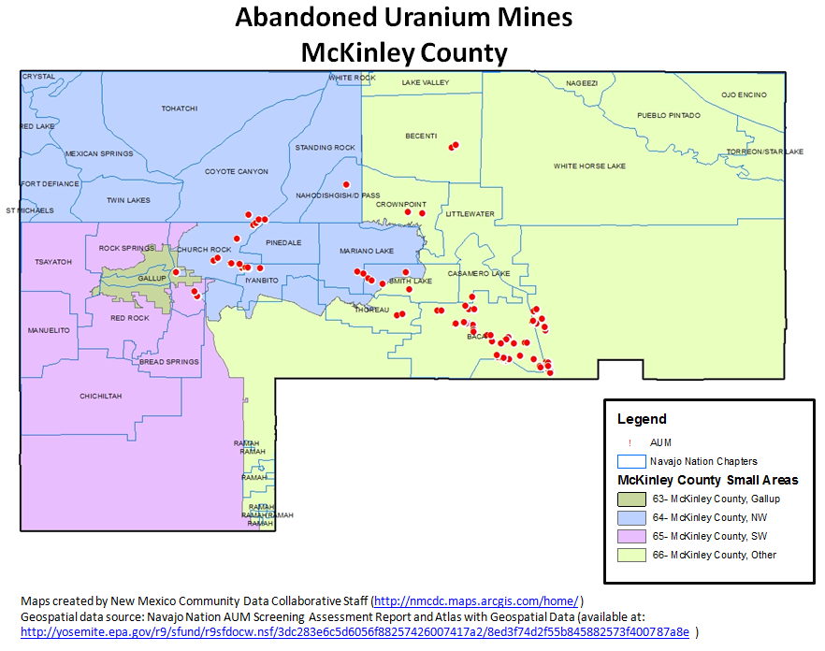

Slide 49
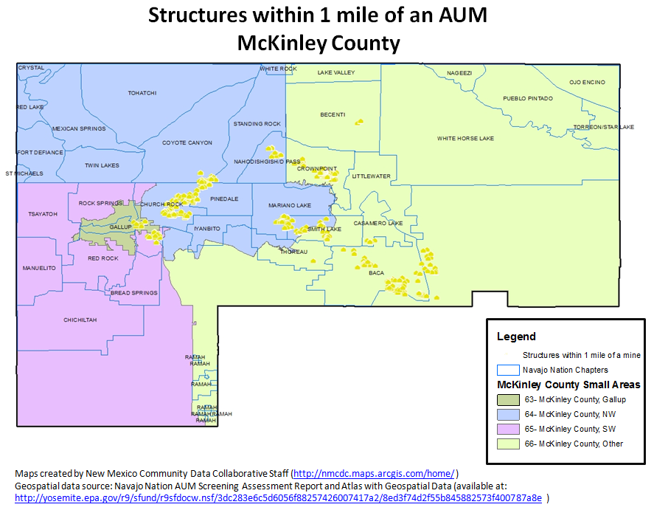

Slide 50
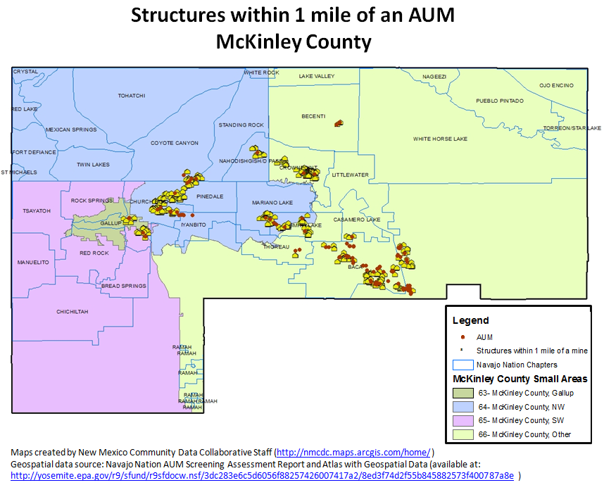
Notes:
Jordon adds final comment on how a state-level Health in All Policies Task Force could support the work going on in local areas.

